Slide 1
ROCK PARADISE
"Your Dreams, Our Code"

Slide 2
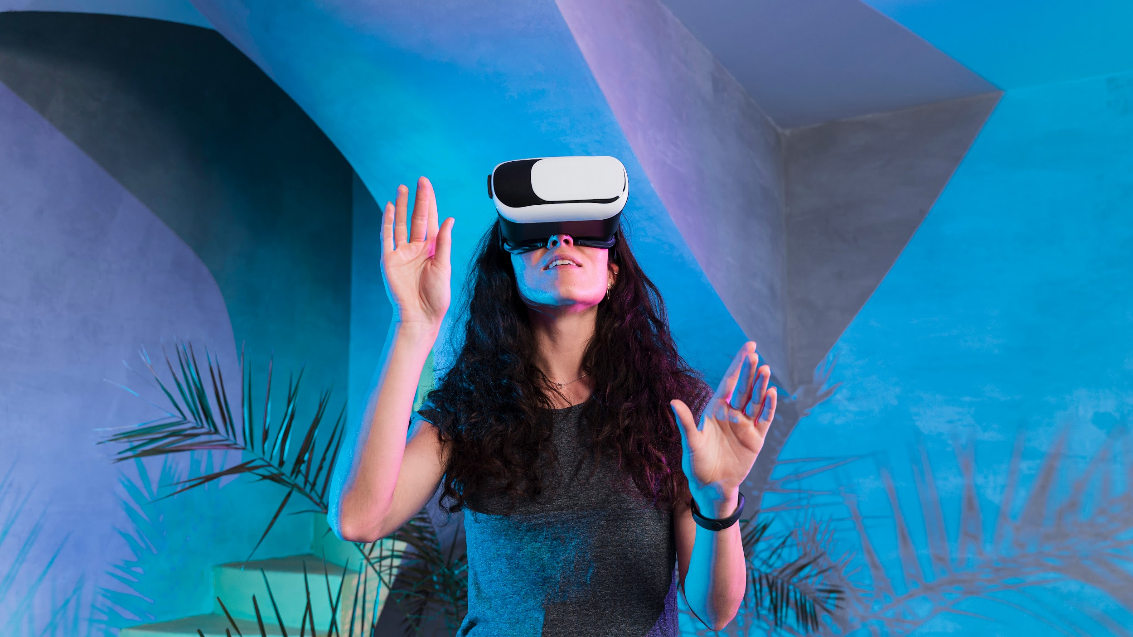
About the Project
ROCK PARADISE
Rock Paradise is the premier online retailer for all things crystals and gemstones. Our extensive collection includes unique stone varieties from all over the world, and we’re always on the hunt for the highest-quality products for our customers!

Slide 3
REQUIREMENTS
The Top of the Page should be presented with a suitable logo and images of diamonds and other crystals.
Categories such as Diamond, Quartz, Ruby, Sapphire, Emerald etc with listing of various jewelry items consisting
these crystals.
Top Selling Items should be listed in a separate category.
Filters based on brand, colour, size etc. should be provided.
Brands like “Swarovski”, “Tiffany”, “Pandora” should be provided in filter.
Gallery should be added for viewing different images.
User Rating must be allowed to enter and viewer should have option to filter on Ratings.
Site map, Gallery, about us, Contact us link must be added.
Contact Us: This menu option should display Email id, address,and contact number.
Section for various offers in the store should be provided with listing of offers with details.
Color combination must be uniform throughout the project.
Navigation must be smooth.
Display a continuous scrolling ticker at the bottom of the page with current date,
time, and location (hint: Use geolocation features of HTML5).
Display a visitor count at the top right corner of the page beside a logo image.
The menu options should change color on hover and also after clicking.
Fade in and fade out options can be used for the menus.

Slide 4
TECHNOLOGIES WE USE
HTML
CSS
JAVASCRIPT

Slide 5

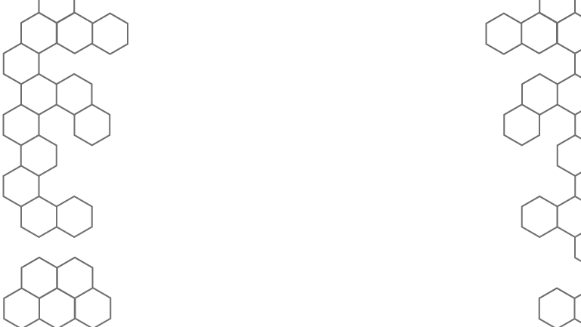
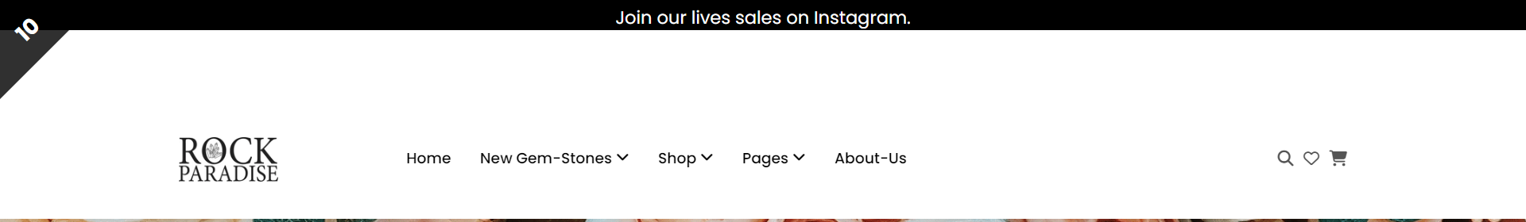
1 ) The Top of the Page should be presented with a suitable logo and images of diamonds and other crystals.

Slide 6

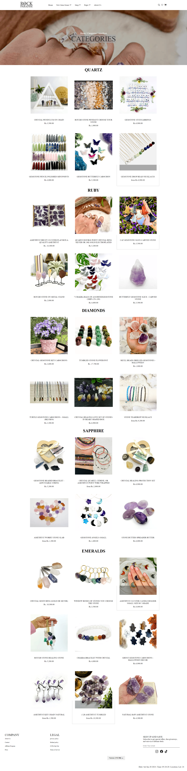
2 ) Categories such as Diamond, Quartz, Ruby, Sapphire, Emerald etc with listing of various jewelry items consisting these crystals.

Slide 7
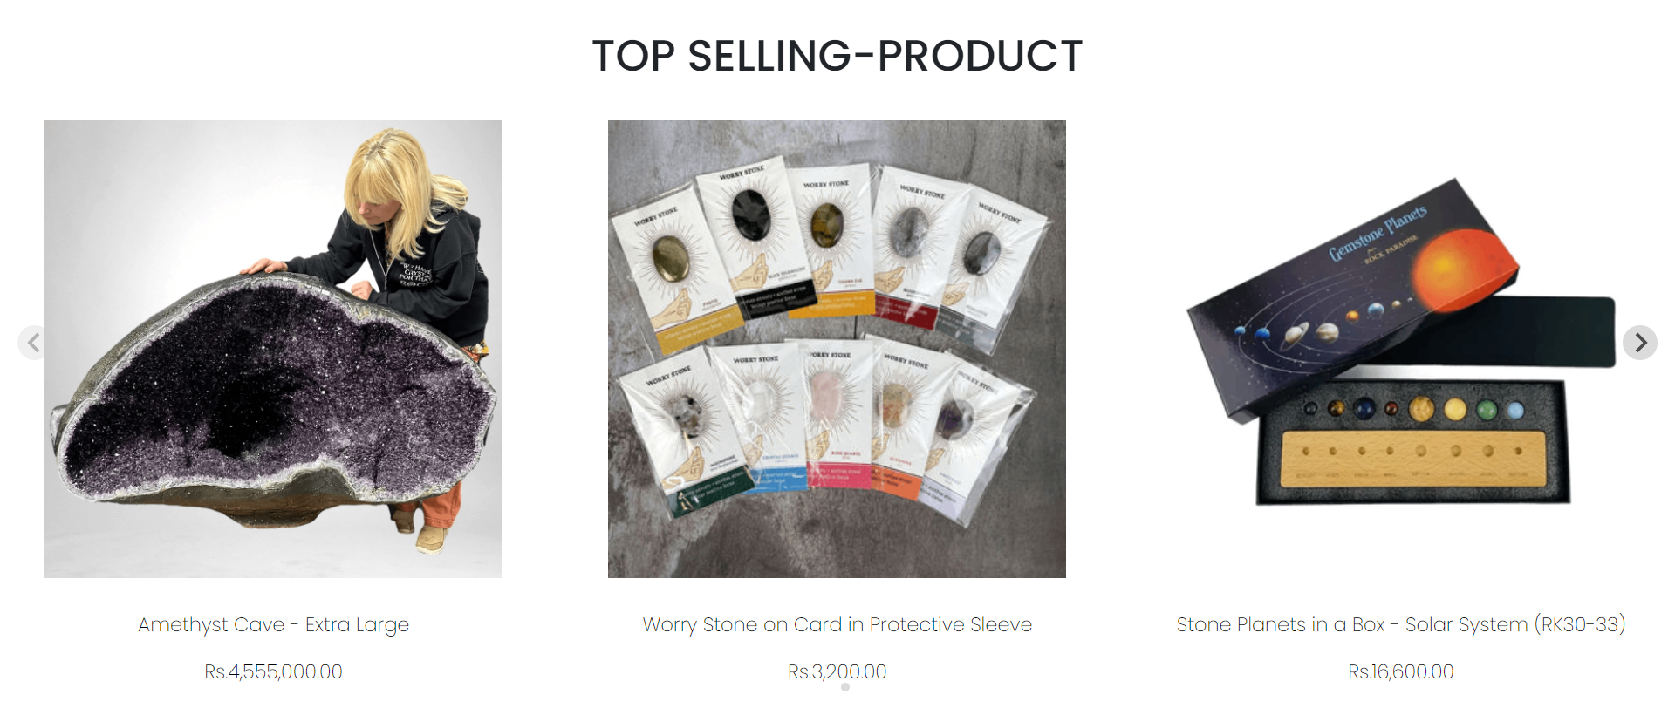
3) Top Selling Items should be listed in a separate category.

Slide 8
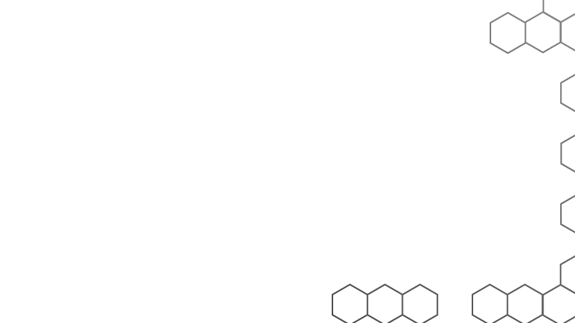
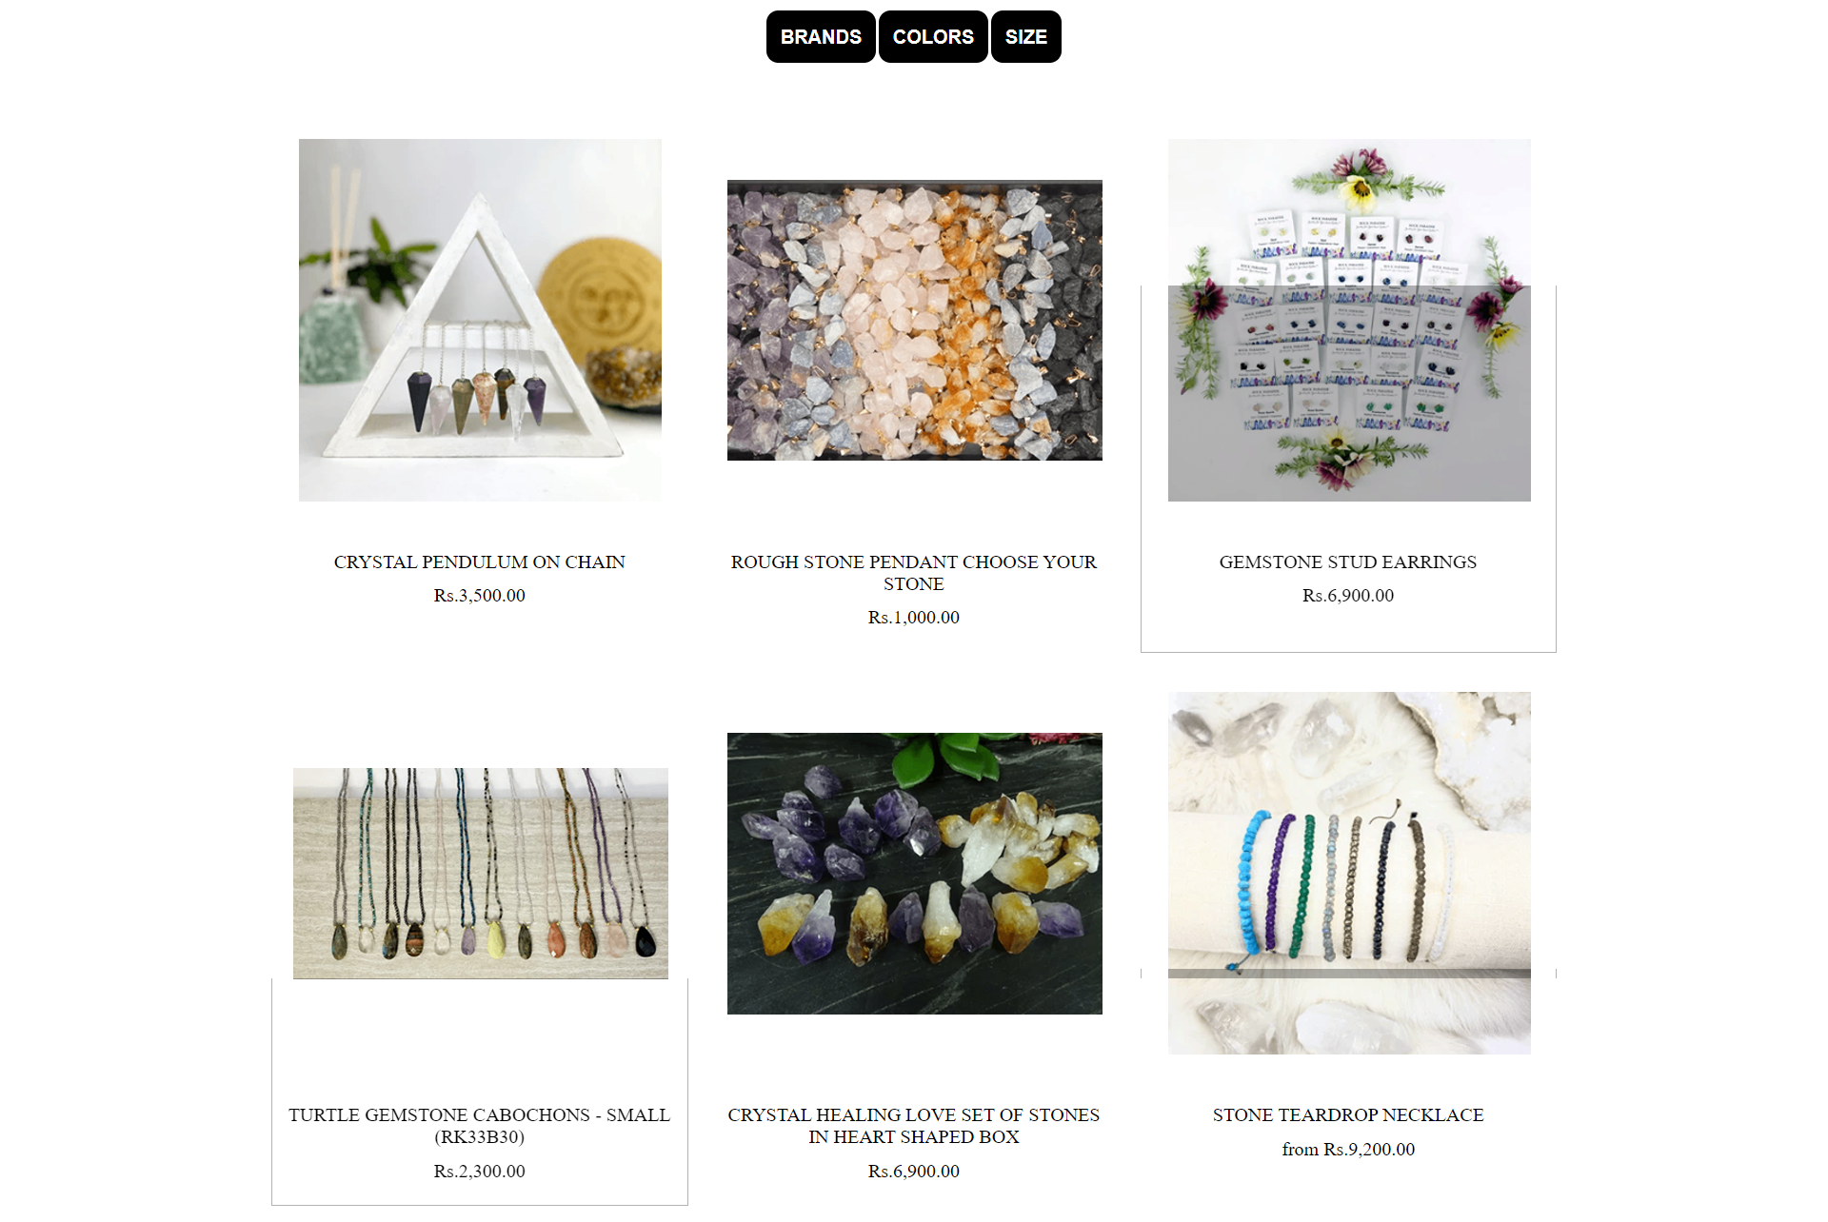
4 ) Filters based on brand, colour, size etc. should be provided

Slide 9
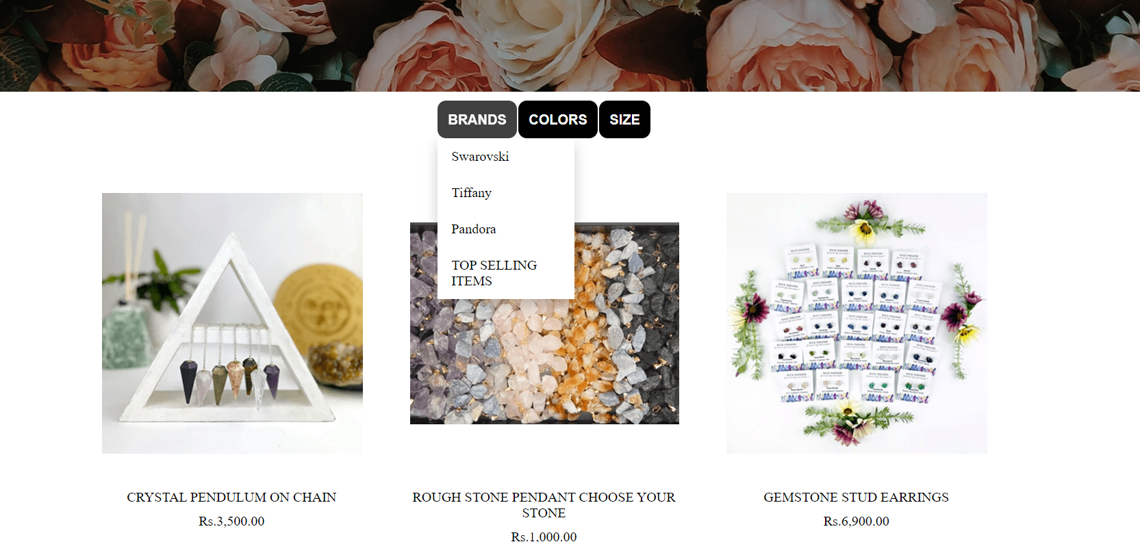
5 ) Brands like “Swarovski”, “Tiffany”, “Pandora” should be provided in filter.

Slide 10
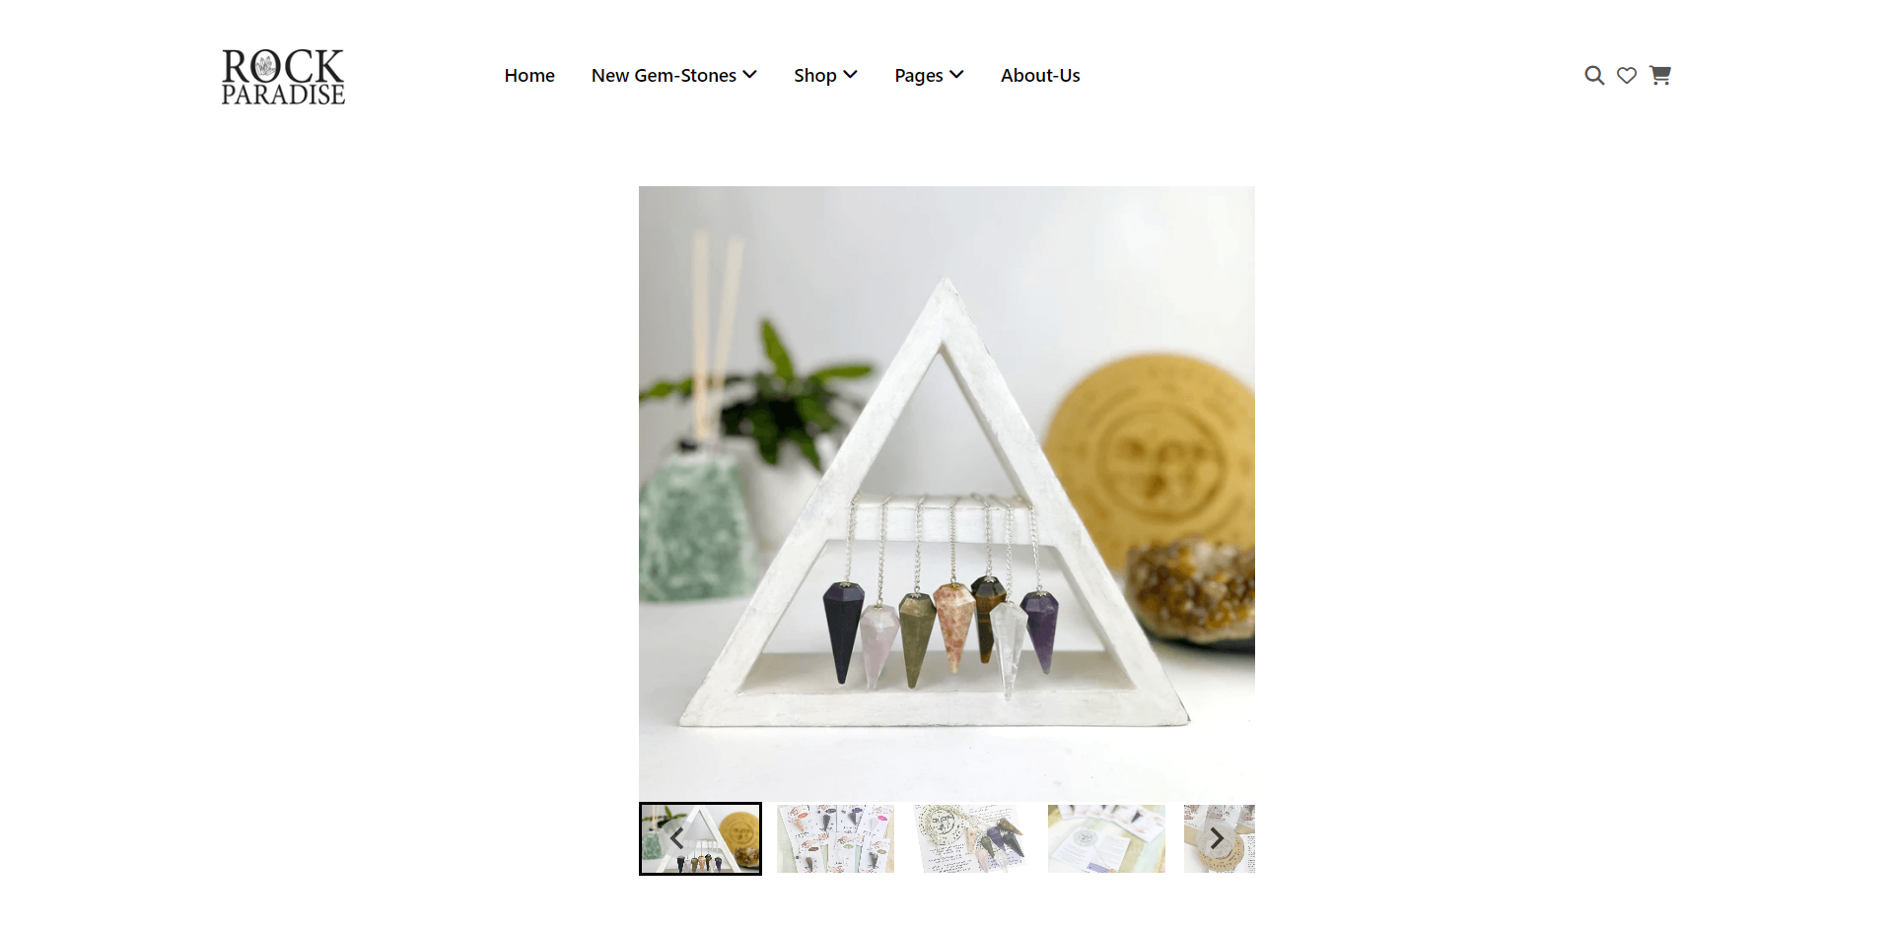
6 ) Gallery should be added for viewing different images.

Slide 11
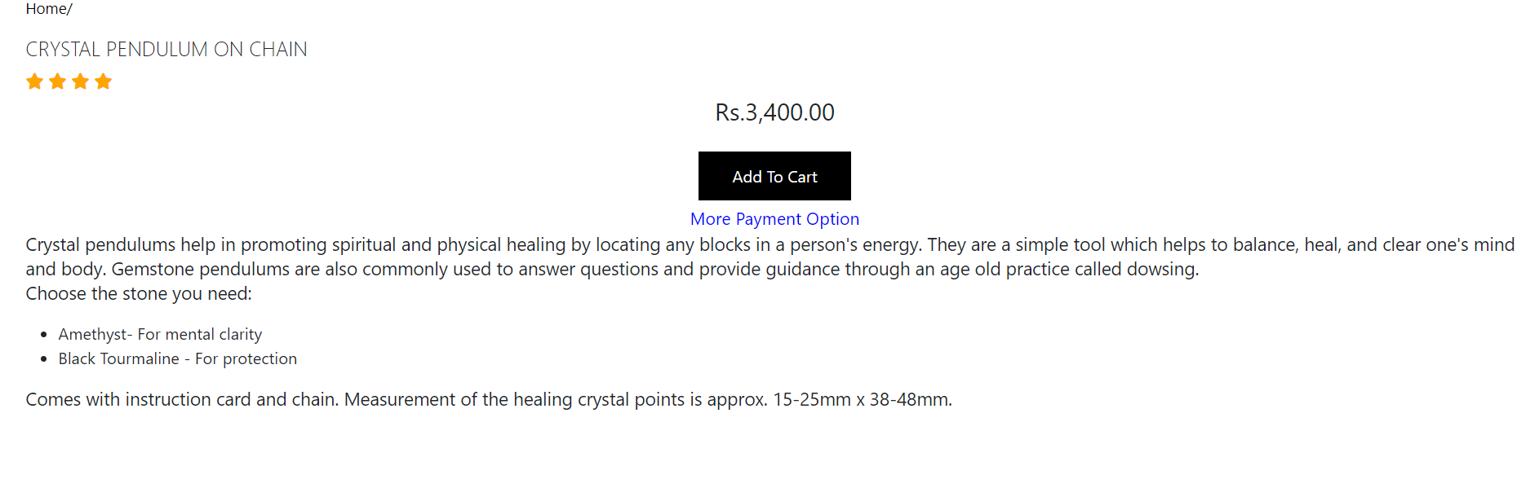
7 ) User Rating must be allowed to enter and viewer should have option to filter on Ratings.

Slide 12
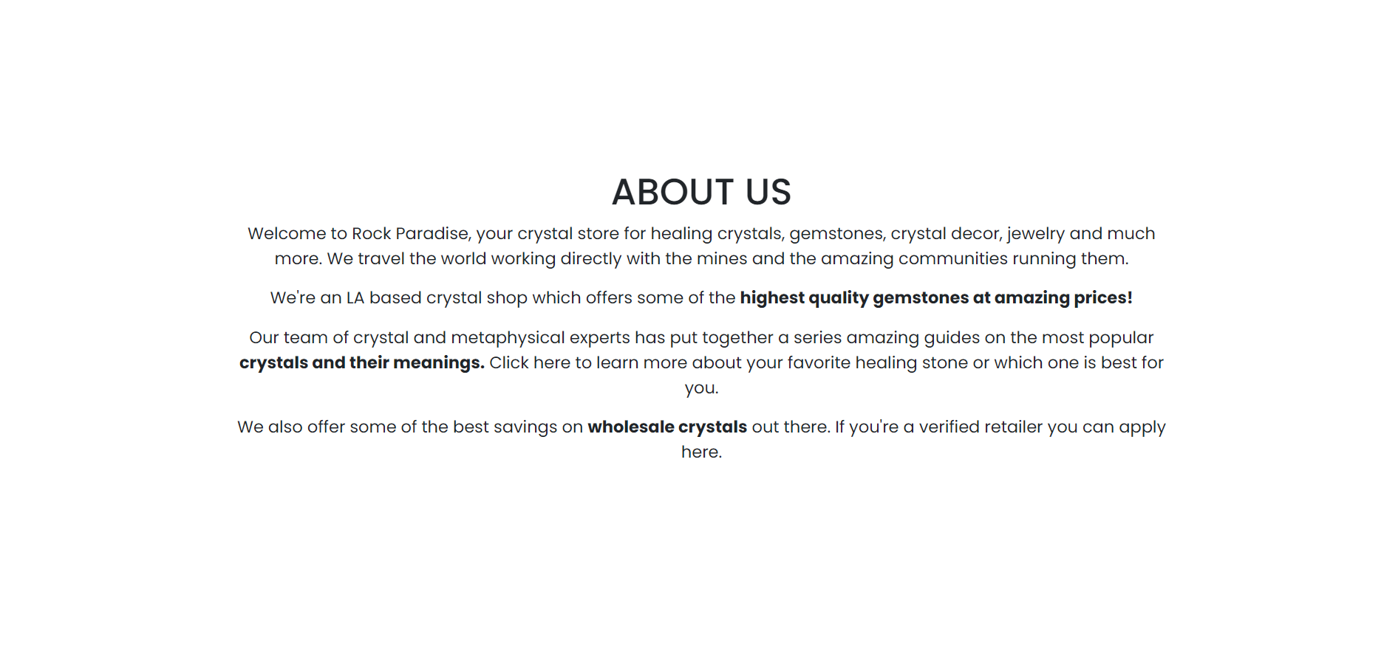
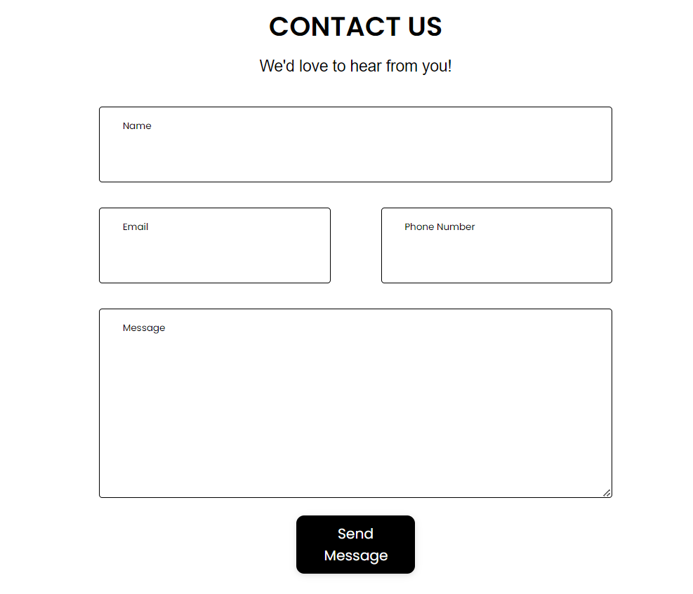
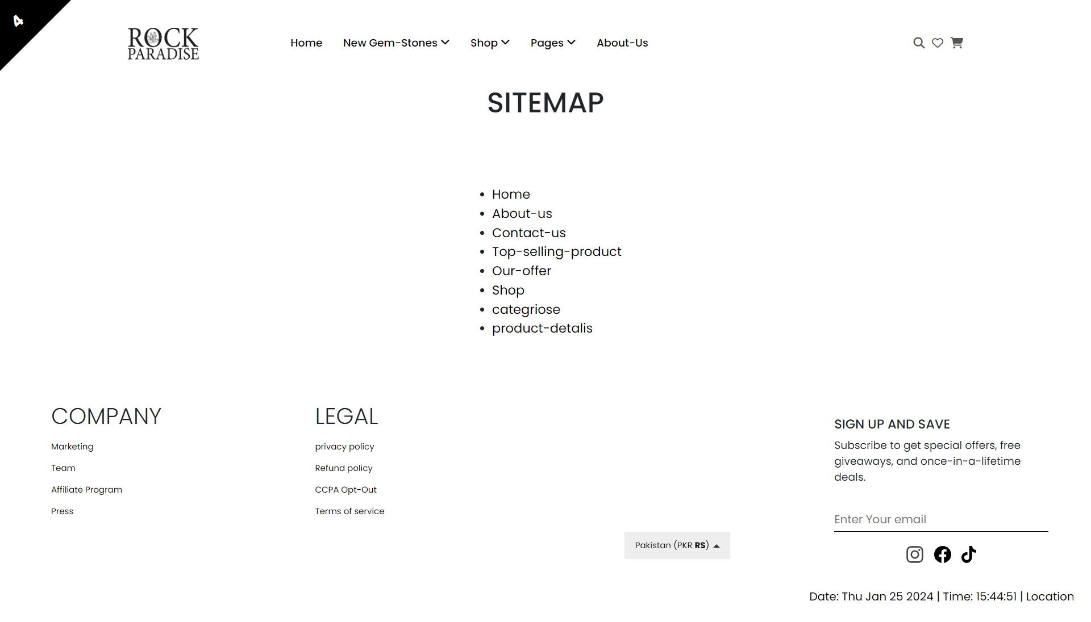
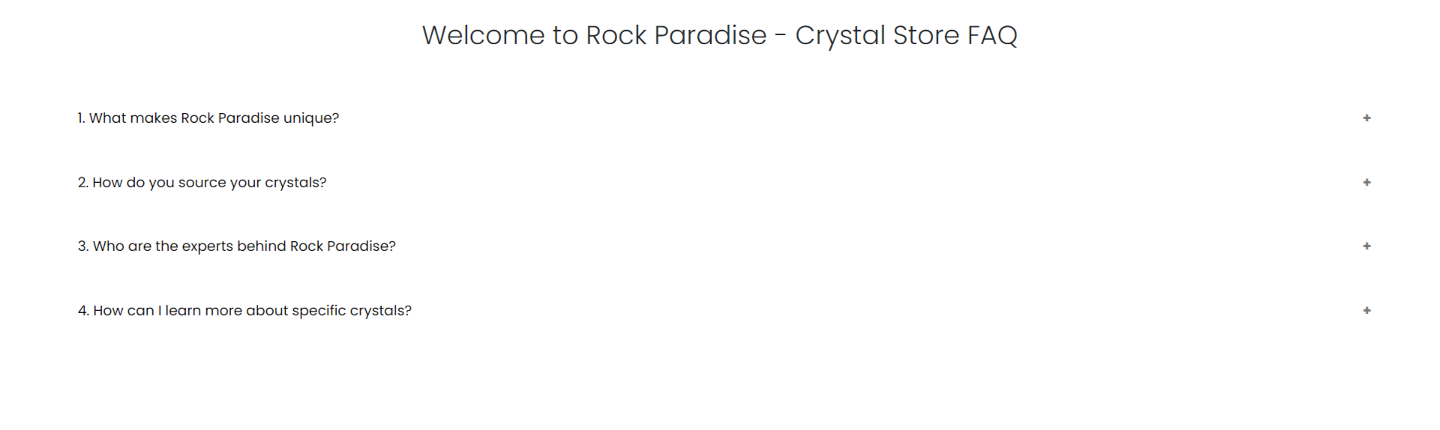
8 ) Site map, about us, and faq Contact us link must be added.

Slide 13
9 ) Contact Us: This menu option should display Email id, Name, and contact number.

Slide 14
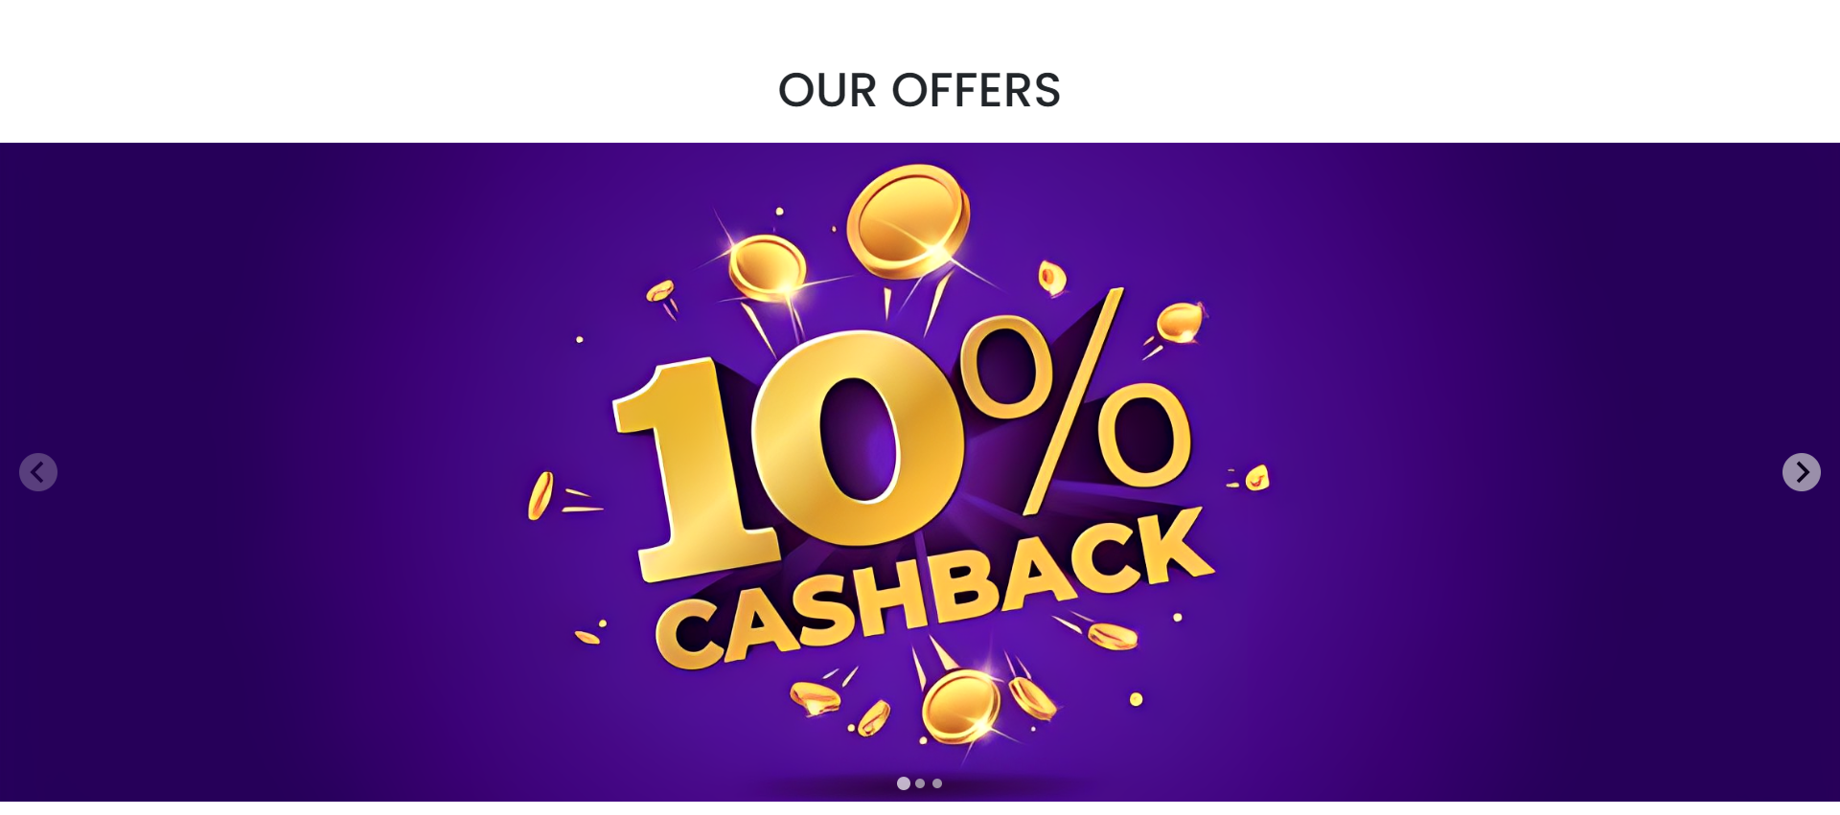
10 ) Section for various offers in the store should be provided with listing of offers with details.

Slide 15
13)Display a continuous scrolling ticker at the bottom of the page with current date, time, and location (hint: Use geolocation features of HTML5)

Slide 16
14)Display a visitor count at the top right corner of the page beside a logo image.

Slide 17

15)The menu options should change color on hover and also after clicking

Slide 18
16)The menu options should change color on hover and also

Slide 19
Our Team
MR.ZUBAIR HASSAN
M.FAIZ BAIG
MR.WAJIH HUSSAIN

Slide 20
Thanks

